Slide 1
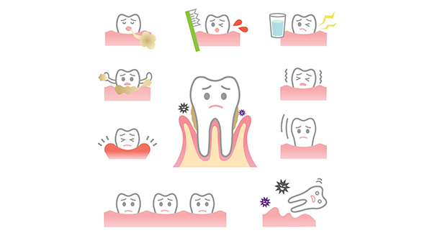
Periodontology –Stage 4
Mobility
By Dr. Huda Jassem
Department of periodontology
College Of Dentistry
University of Basrah
University of Basrah-College of Dentistry-Department of Periodontology

Slide 2
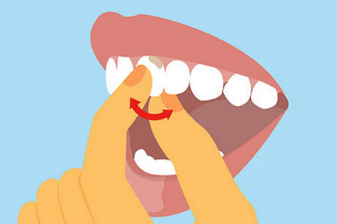
Contents
Introduction
Physiological Mobility
Pathological Mobility
Causes of Tooth Mobility
Factors that govern tooth mobility in a horizontal direction
Classification of tooth mobility (T.M.)
Sign & Symptoms of T.M
Treatment of increased tooth mobility
University of Basrah-College of Dentistry-Department of Periodontology

Slide 3
Today’s Phrase

Slide 4
Introduction
Mobility
University of Basrah-College of Dentistry-Department of Periodontology

Slide 5
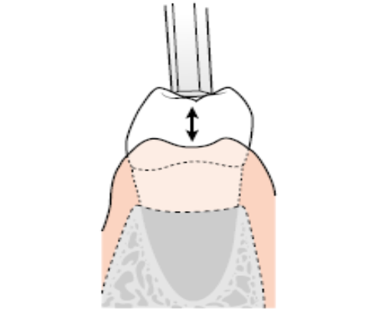
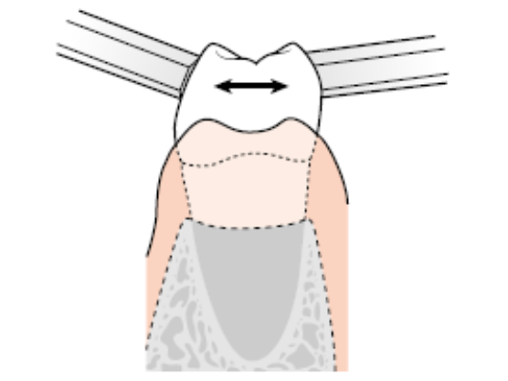
Introduction
Tooth Mobility??
MOBILITY
Horizontal
Vertical
University of Basrah-College of Dentistry-Department of Periodontology

Slide 6
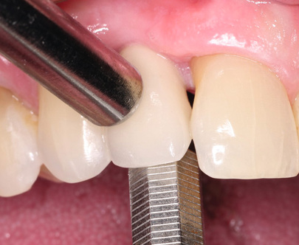
Introduction
MOBILITY
Physiological
Pathological

Slide 7
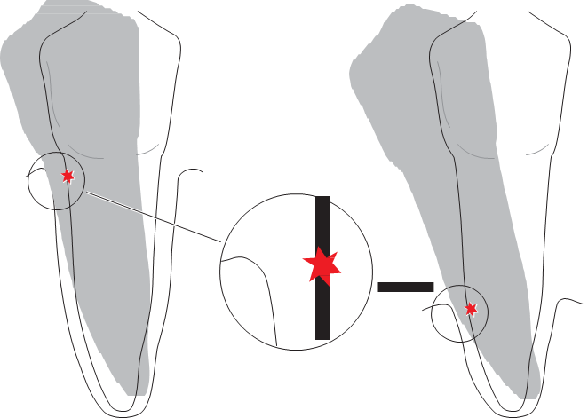
Physiological Mobility
Definition
Conditions
University of Basrah-College of Dentistry-Department of Periodontology

Slide 8
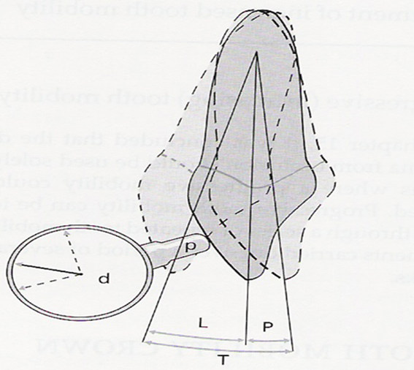
Physiological Mobility
Initial & Secondary Tooth Mobility
Muehlemann (1954, 1960)
Periodontometer
100 pounds→0.05-0.1 mm.
500 pounds →
Incisors 0.1-0.12 mm
Canines 0.05-0.09 mm
Premolars 0.08-0.1 mm
Molars 0.04-0.08 mm
University of Basrah-College of Dentistry-Department of Periodontology

Slide 9
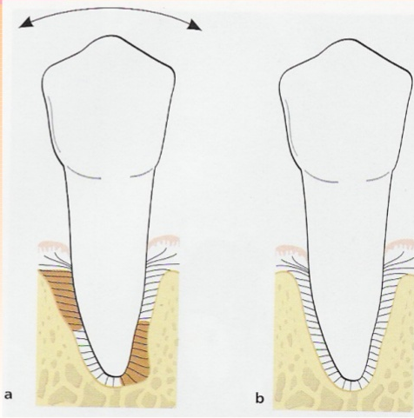
Pathological Mobility
Definition
University of Basrah-College of Dentistry-Department of Periodontology

Slide 10
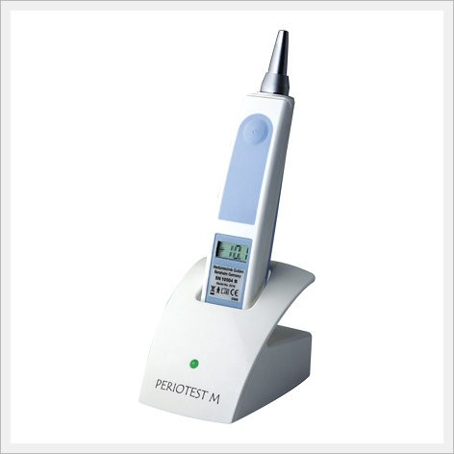
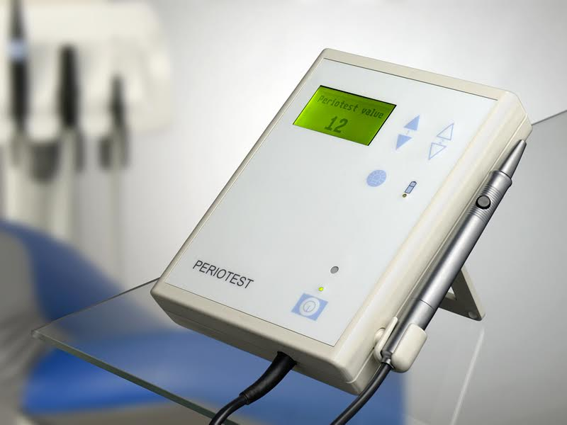
Mobility
Device (Periotest)
University of Basrah-College of Dentistry-Department of Periodontology

Slide 11
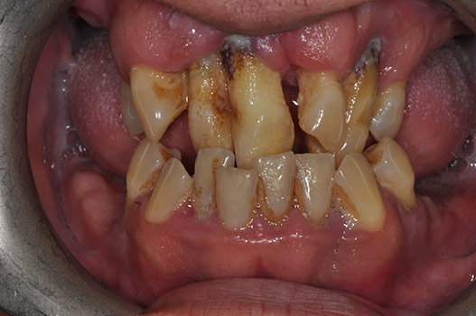
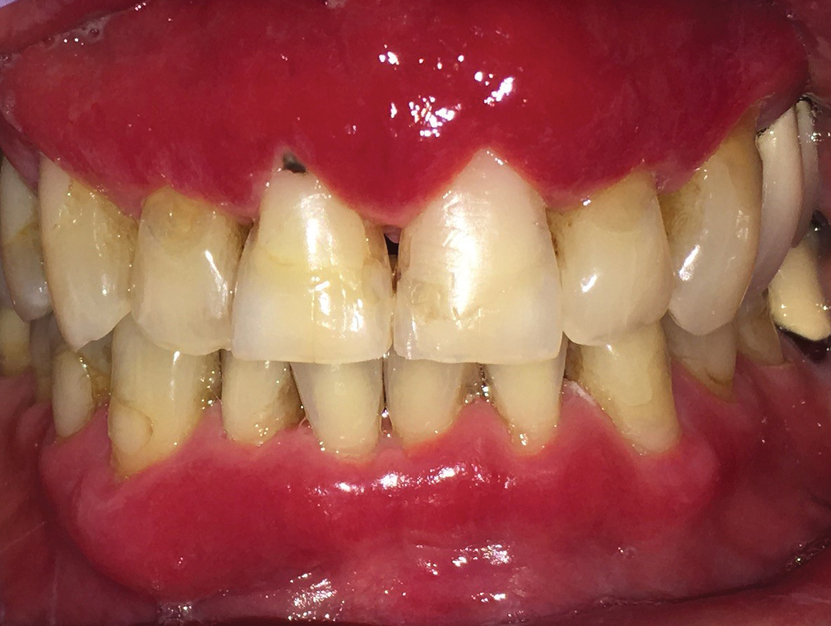
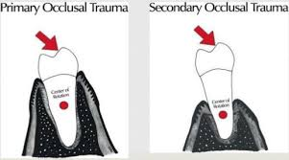
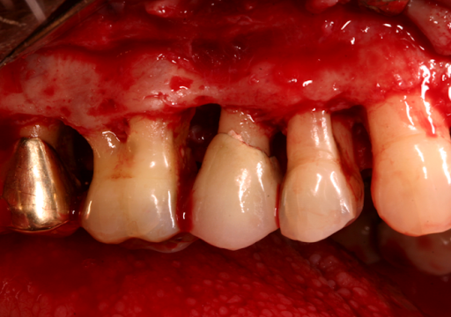
Causes of Tooth Mobility
University of Basrah-College of Dentistry-Department of Periodontology

Slide 12
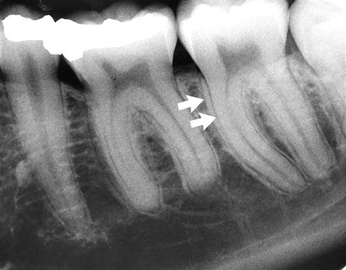
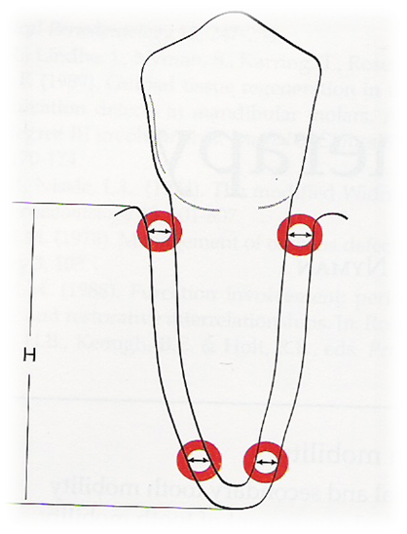
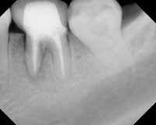
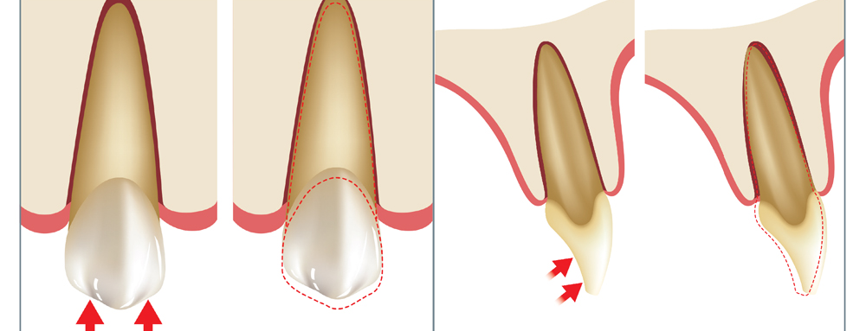
Factors that govern tooth mobility in a horizontal direction
University of Basrah-College of Dentistry-Department of Periodontology

Slide 13
Classification of tooth mobility(T.M.)
Degree 0
Degree 1
Degree 2
Degree 3
University of Basrah-College of Dentistry-Department of Periodontology

Slide 14
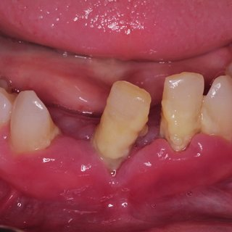
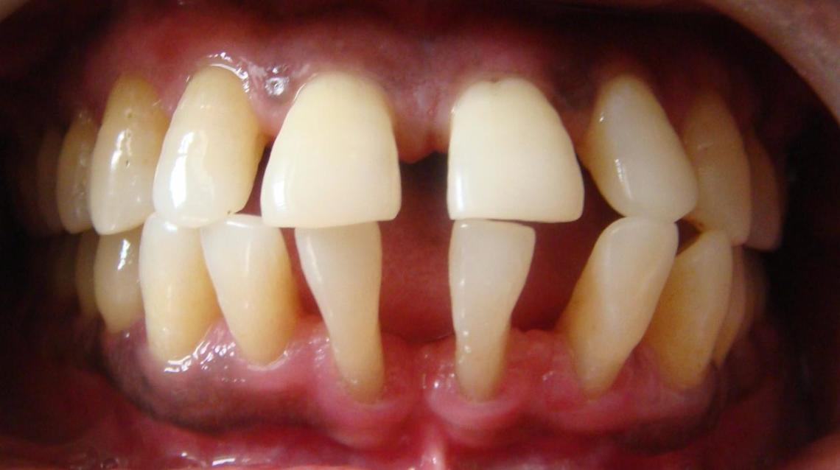
Sign & Symptoms of T.M
University of Basrah-College of Dentistry-Department of Periodontology

Slide 15
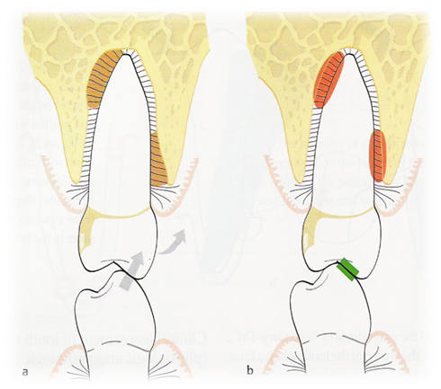
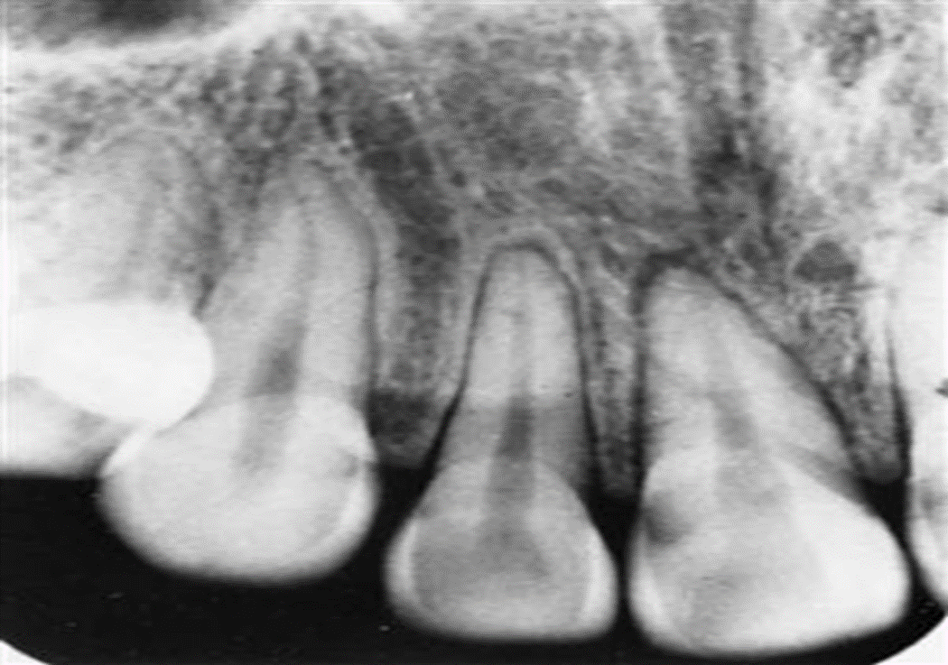
Treatment of increased tooth mobility
Situation I:
Increased mobility of a tooth with increased width of the periodontal ligament but normal height of the alveolar bone
University of Basrah-College of Dentistry-Department of Periodontology

Slide 16
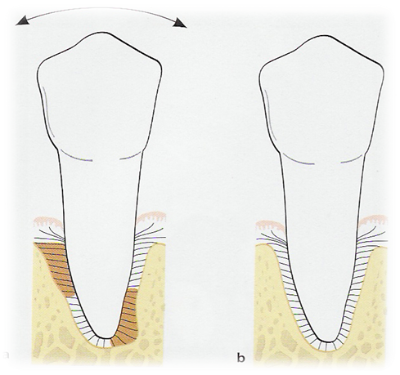
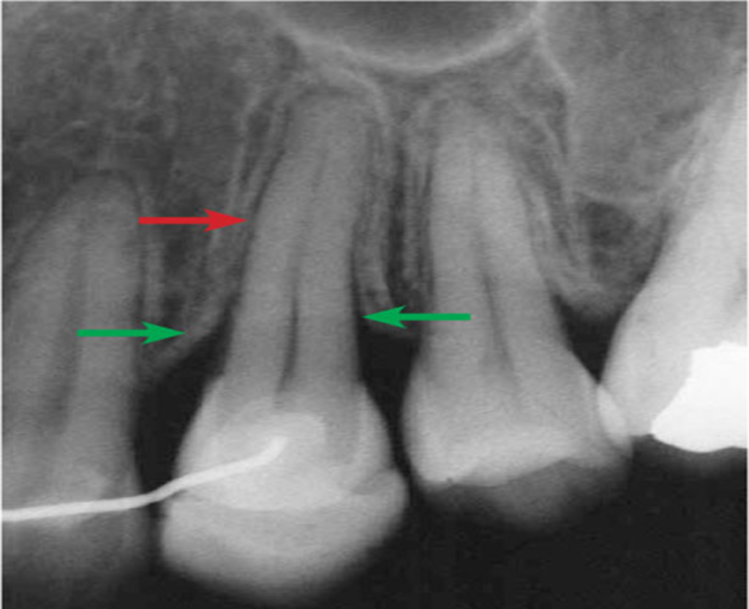
Treatment of increased tooth mobility
Situation II:
Increased mobility of a tooth with increased width of P. D. ligament& reduced height of alveolar bone
University of Basrah-College of Dentistry-Department of Periodontology

Slide 17
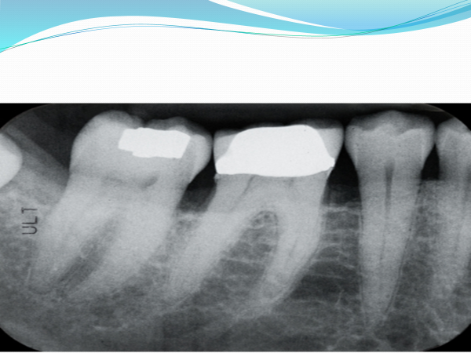
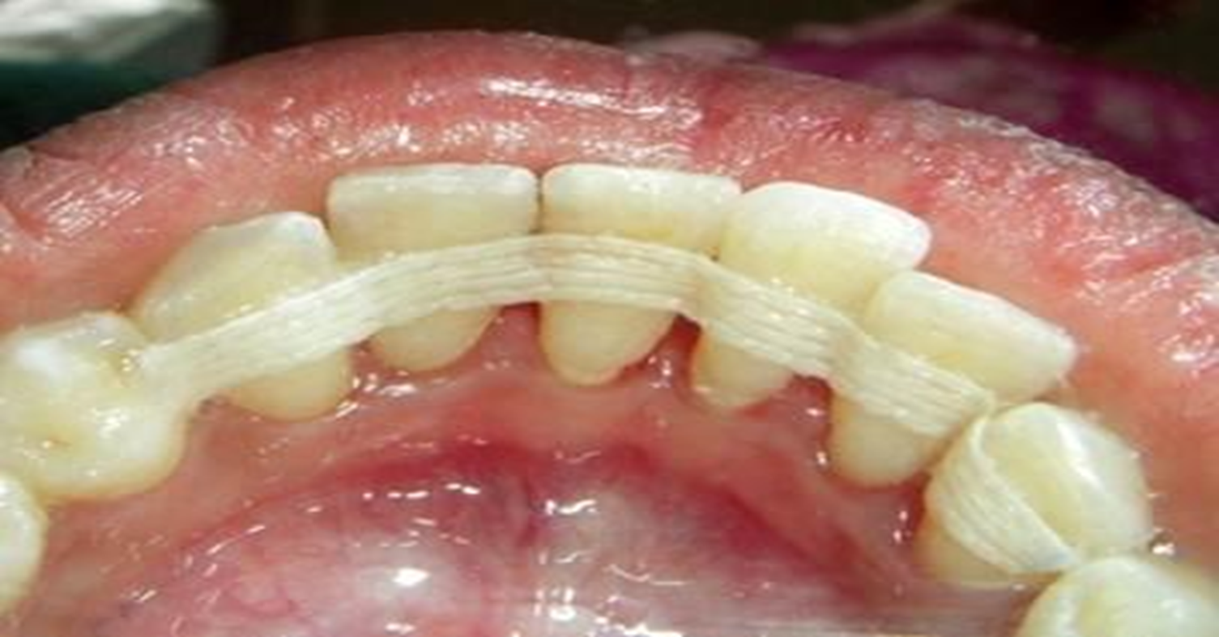
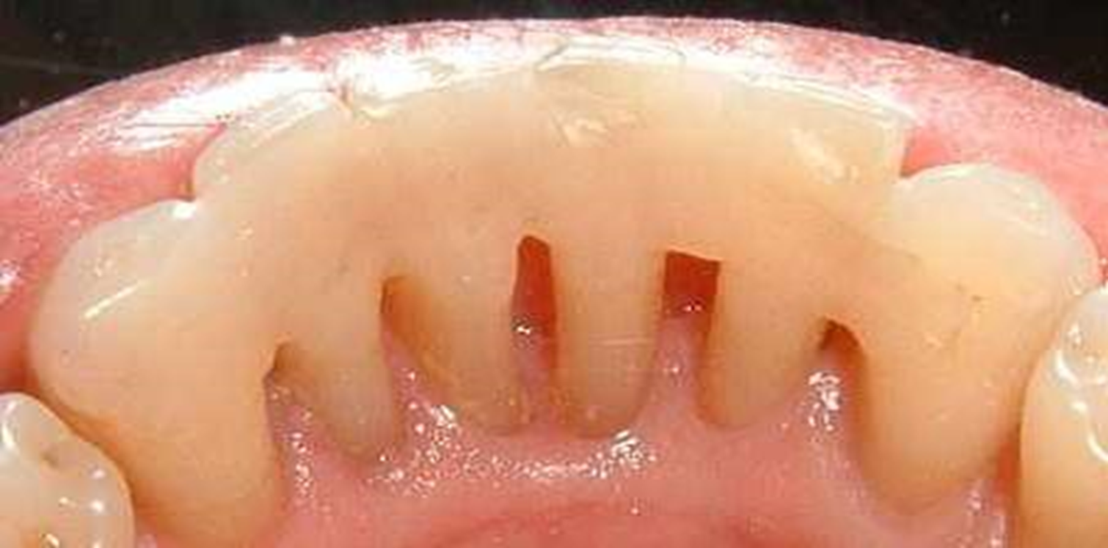
Treatment of increased tooth mobility
Situation III:
Increased mobility of a tooth with reduced height of alveolar bone & normal width of P.D. ligament.
University of Basrah-College of Dentistry-Department of Periodontology

Slide 18
Treatment of increased tooth mobility
Situation III:
Increased mobility of a tooth with reduced height of alveolar bone & normal width of P.D. ligament.
https://youtu.be/NKtuA1uPjnU
(watch video for Ribbond Periodontal Splint Technique)
University of Basrah-College of Dentistry-Department of Periodontology

Slide 19
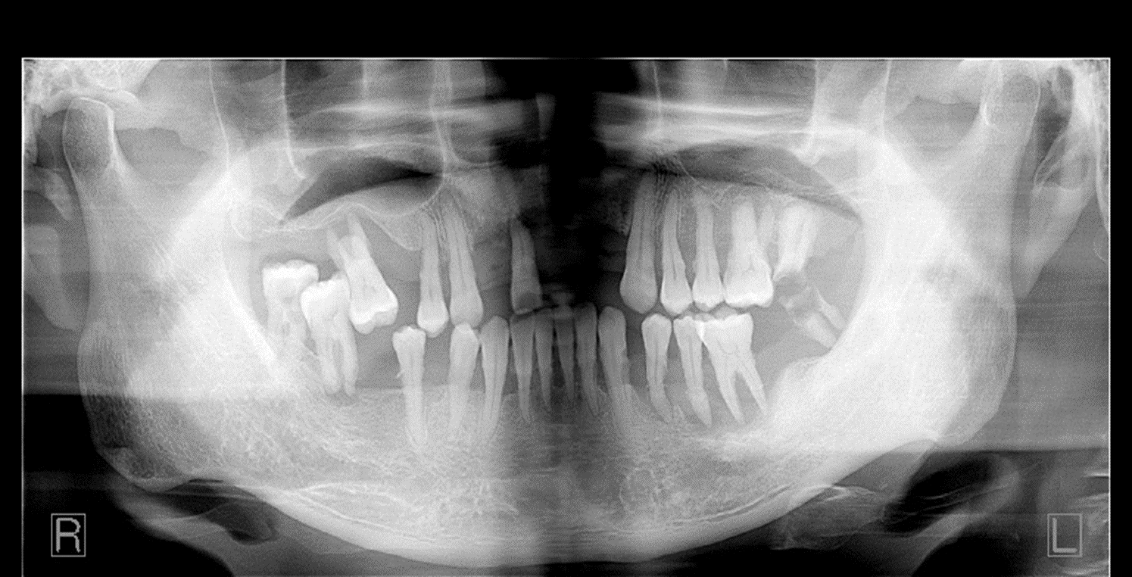
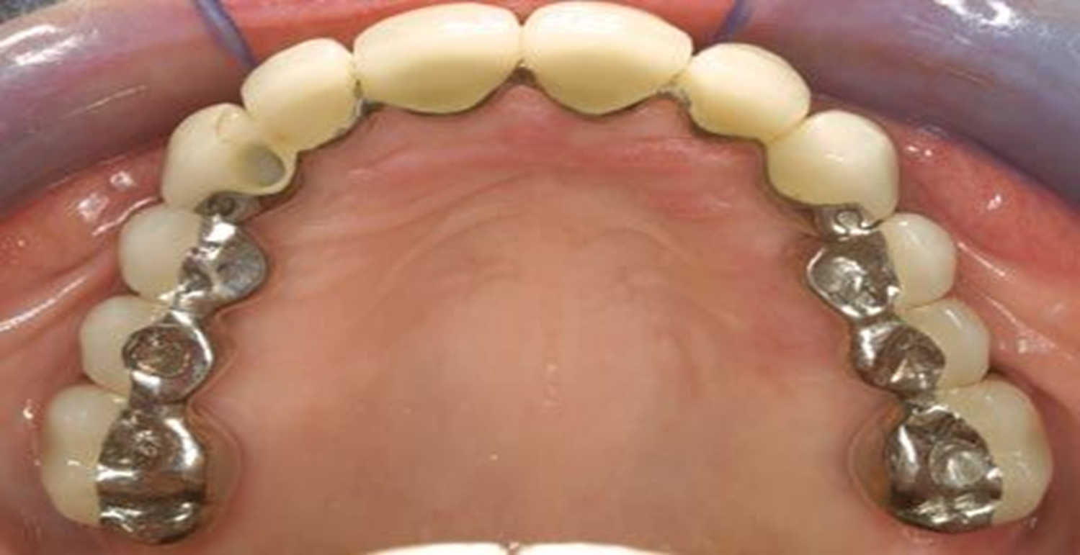
Treatment of increased tooth mobility
Situation IV:
Progressive (increasing) mobility of a tooth (teeth) as a result of gradually increasing width of P.D. ligament in teeth with reduced height of alveolar bone
University of Basrah-College of Dentistry-Department of Periodontology

